Slide 1
Lecture Module 3: Our EEG Systems A brief introduction to our available EEG systems
NDCLab
Florida International University
George Buzzell does not take credit for any of the images presented in these lecture slides. If not otherwise indicated, all images were sourced identified through generic google image searches. Appropriate credit for all images/figures can be identified through a reverse image search or by requesting this information directly from George Buzzell at gbuzzell@fiu.edu.

Slide 2
Module overview
EGI 128-channel saline-net high-impedance system
Brain Vision 128-channel gel-based active system
OpenBCI 16-channel dry electrode mobile system
Following module: Collecting and Monitoring EEG

Slide 3

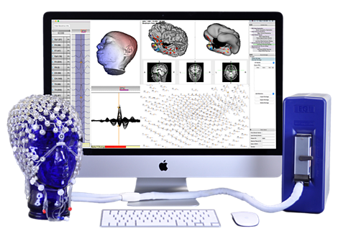
EGI 128-channel saline-net high-impedance system

Slide 4
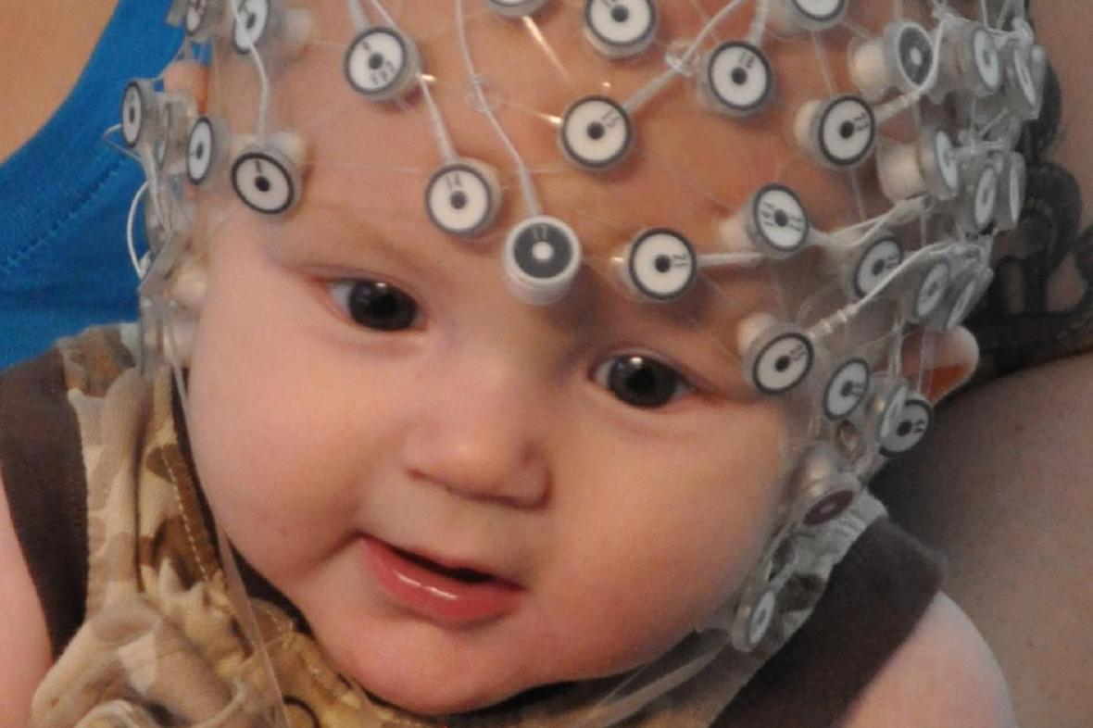
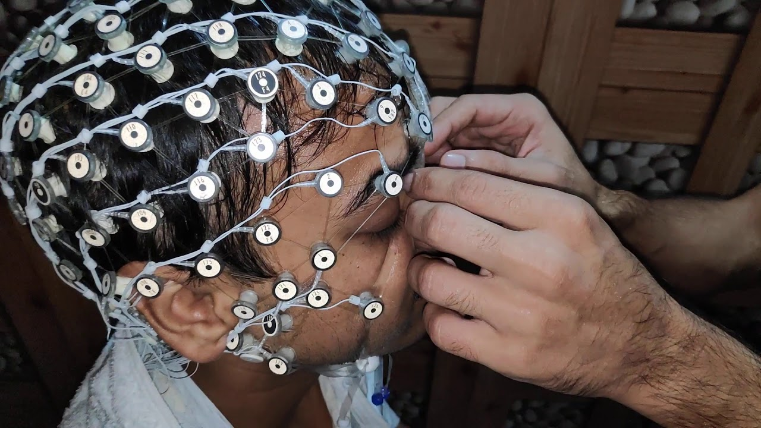
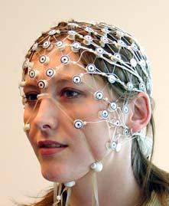
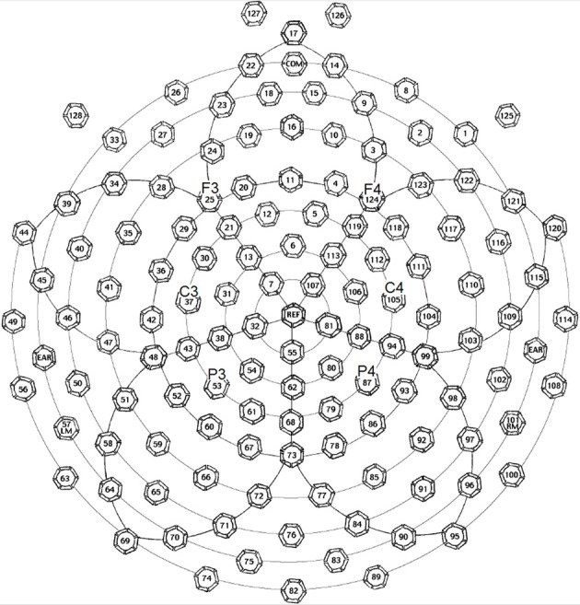
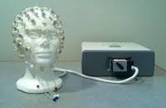

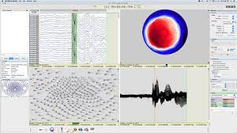
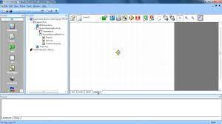
Specifications (EGI 128-channel system)
Netamps 400 amplifier
64-channel geodesic nets for infant-adult
128-channel geodesic nets for children-adult
Netstation 5.0
ePrime 2.0 for stimulus presentation

Slide 5
Usage (EGI 128-channel system)
Great for quickly collecting high-density EEG
Well tolerated by infants/children
We will likely use for infant/child studies

Slide 6
Caveats (EGI 128-channel system)
Increased likelihood of bridged electrodes
Must re-apply saline for recordings more than 15-20 mins
Does not use standard 10-5 (10-20 layout)
Traditionally, EGI is optimized for use with ePrime…

Slide 7
Documentation (EGI 128-channel system)
https://www.egi.com/knowledge-center

Slide 8
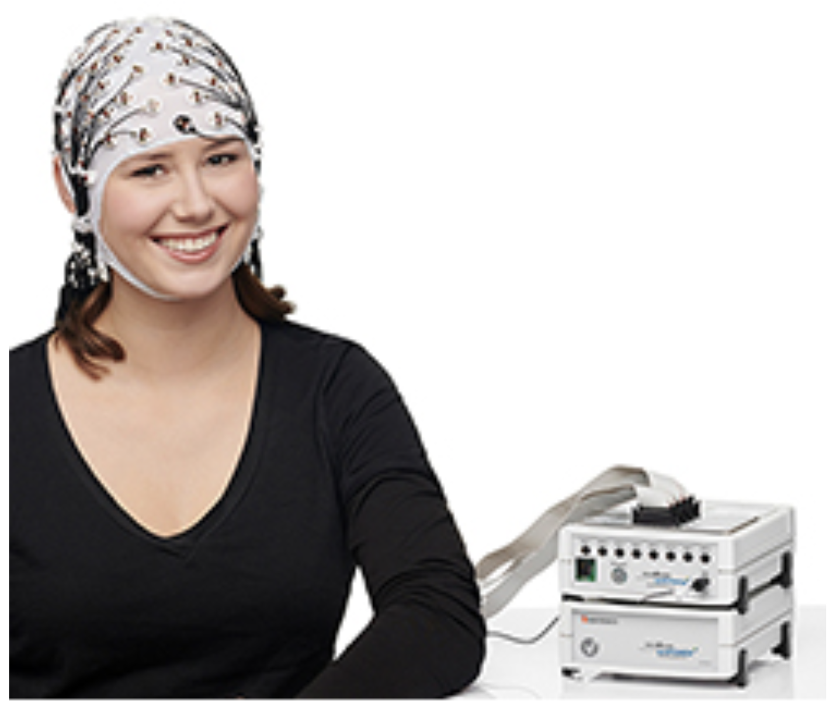
Brain Vision 128-channel gel-based active system

Slide 9
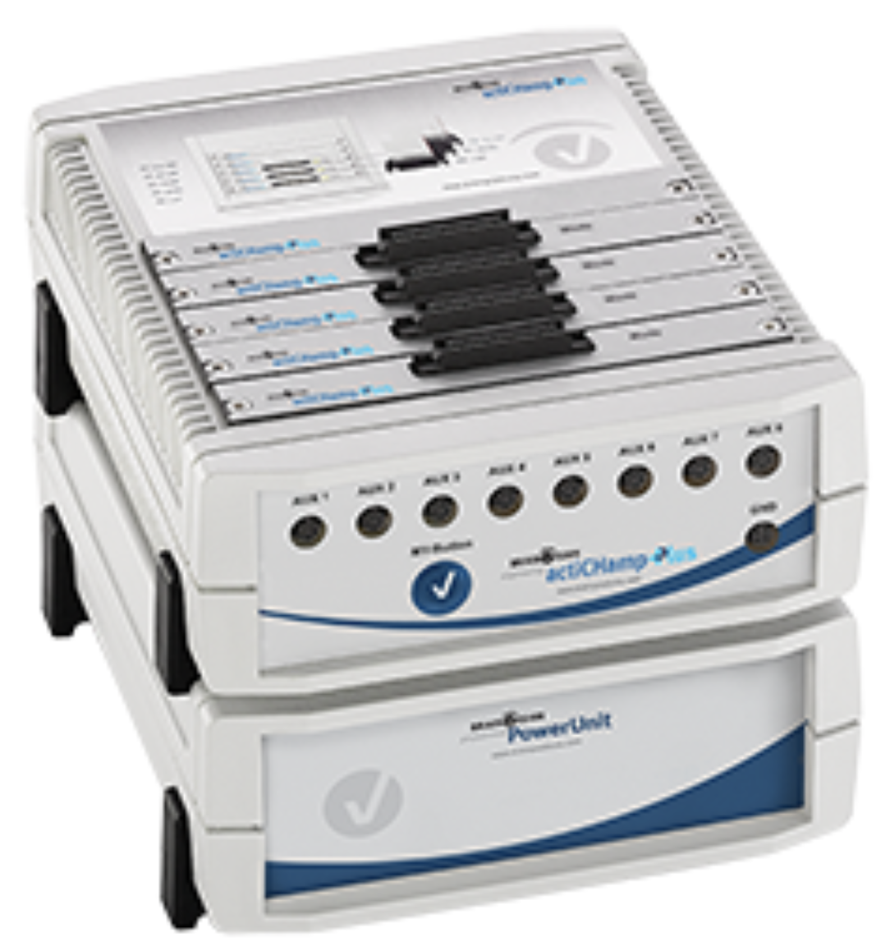
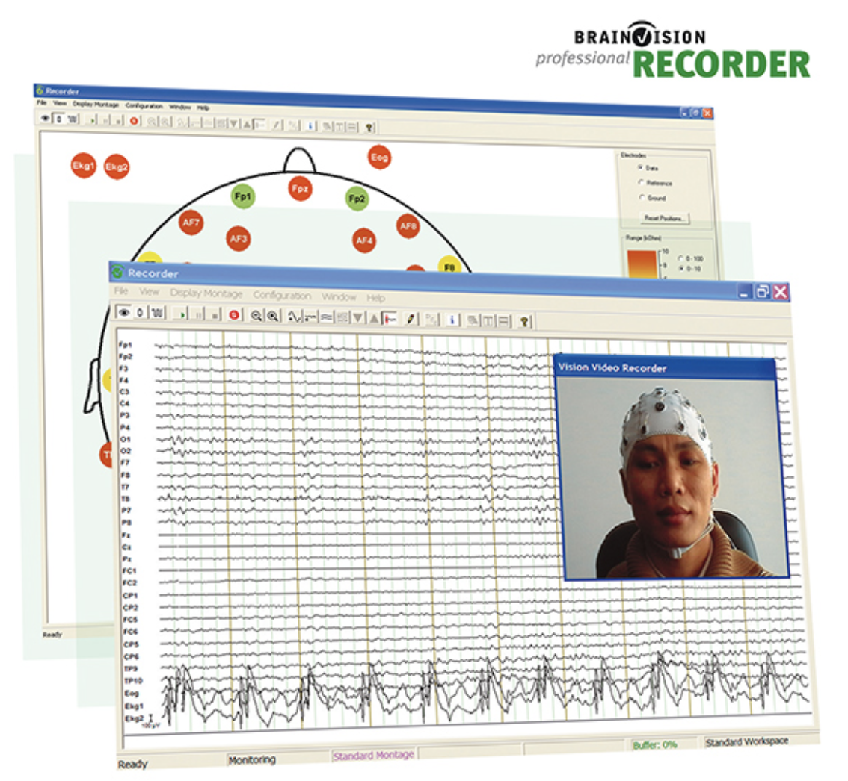
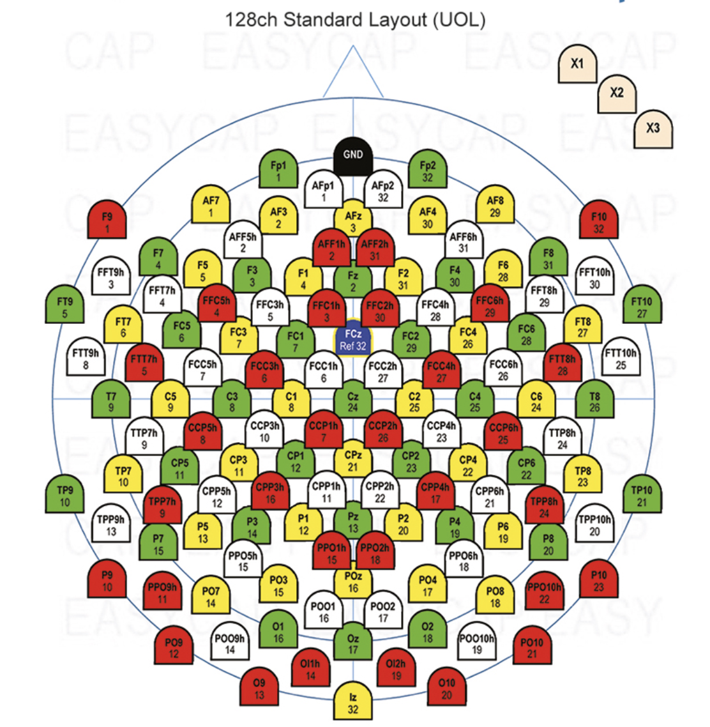
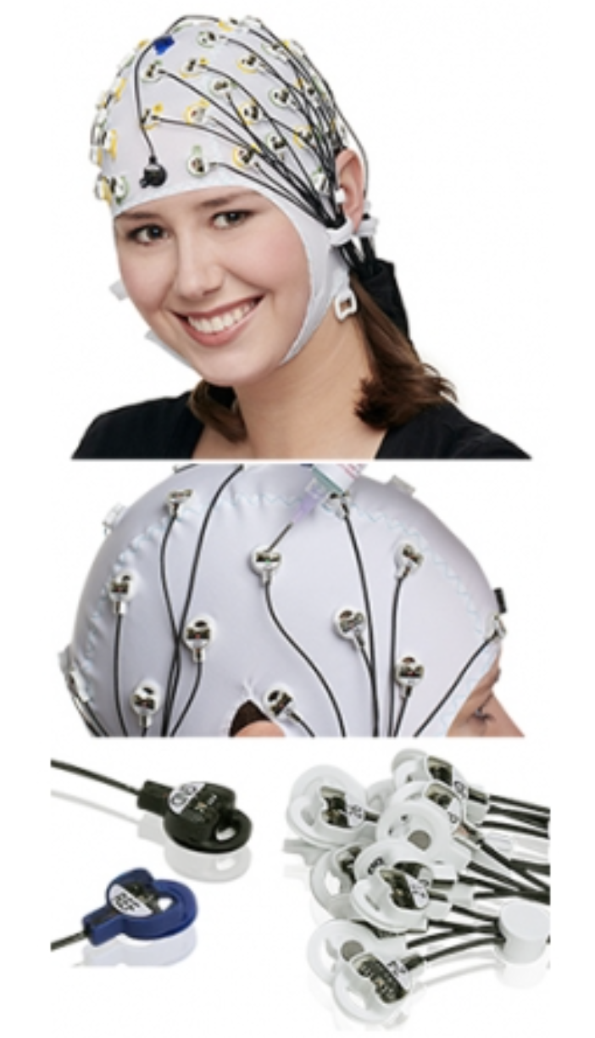
Specifications (Brain Vision 128-channel system)
ActiCap Slim electrodes (removable)
Cap sizes for child-adult
Standard (10-5) and custom equidistant layouts
ActiChamp Plus amplifier and battery

Slide 10
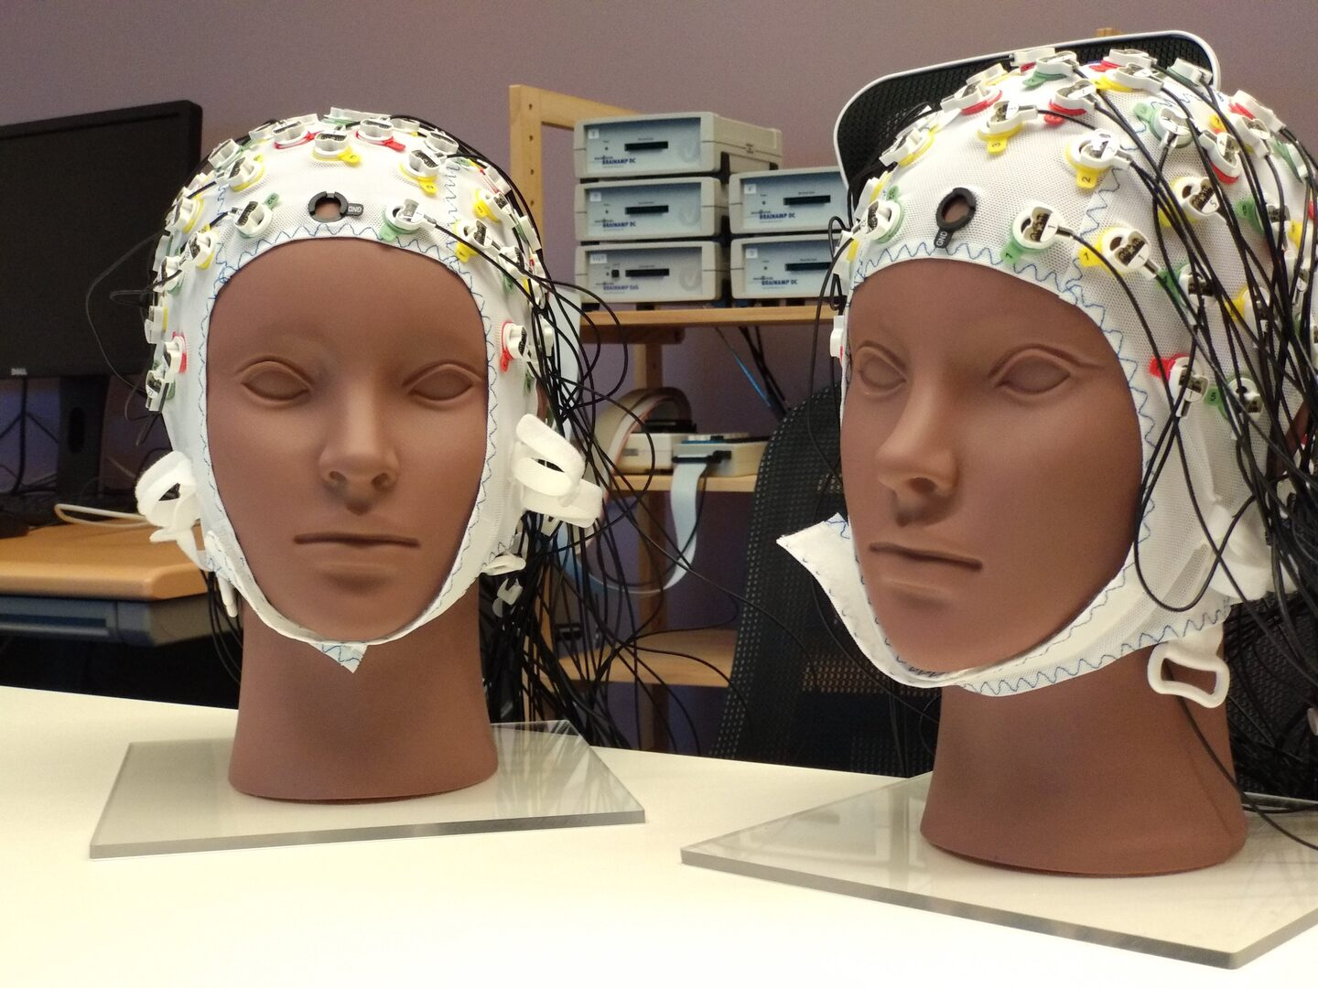
Usage (Brain Vision 128-channel system)
Ideally suited for longer, high-quality data collection
Well-tolerated by adolescents or adults
Will be the “standard system” that we use for most studies
Our system set up to be “semi-mobile”
Set up to split into two 64 channel systems

Slide 11
Caveats (Brain Vision 128-channel system)
Much longer set-up time
Discomfort associated with applying the cap
Not suitable for infants and ideally not children either…

Slide 12
Documentation (Brain Vision 128-channel system)
Website: https://brainvision.com/products/actichamp-plus/
Documentation on disk

Slide 13
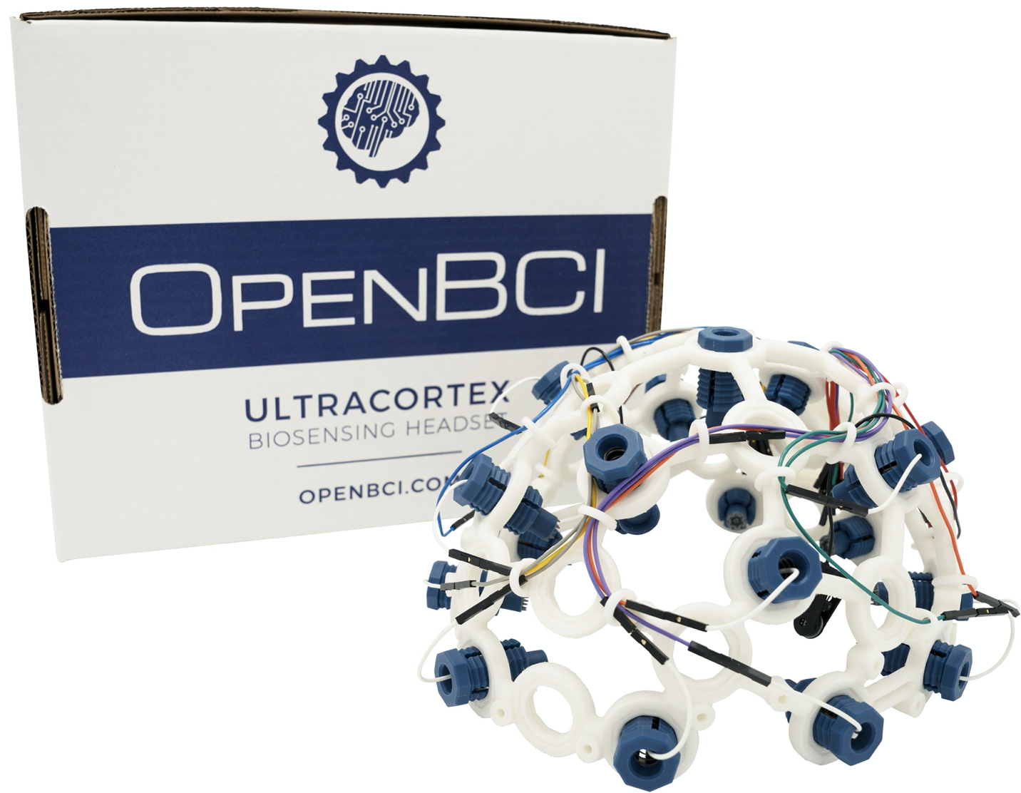
OpenBCI 16-channel dry electrode mobile system

Slide 14
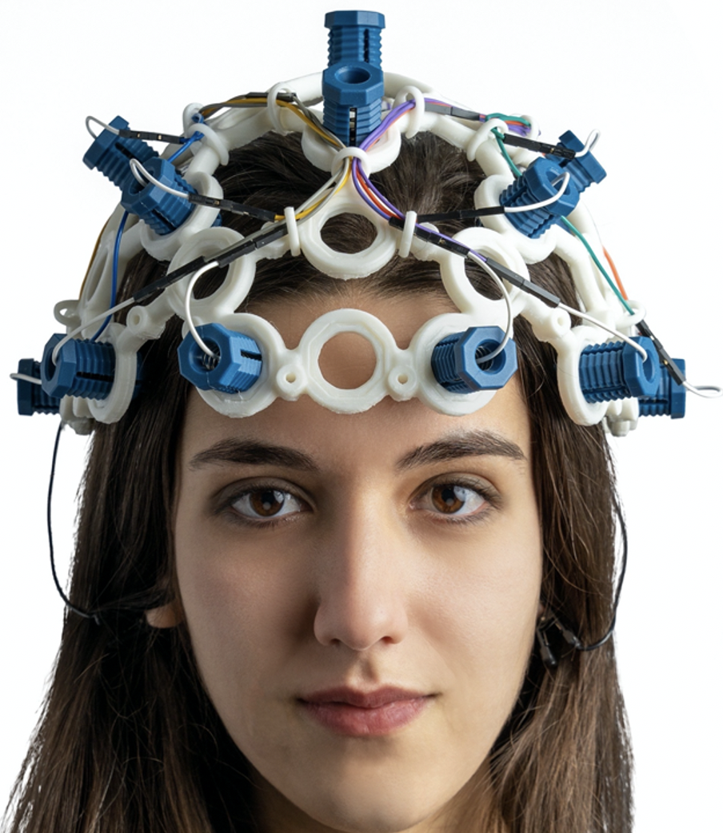
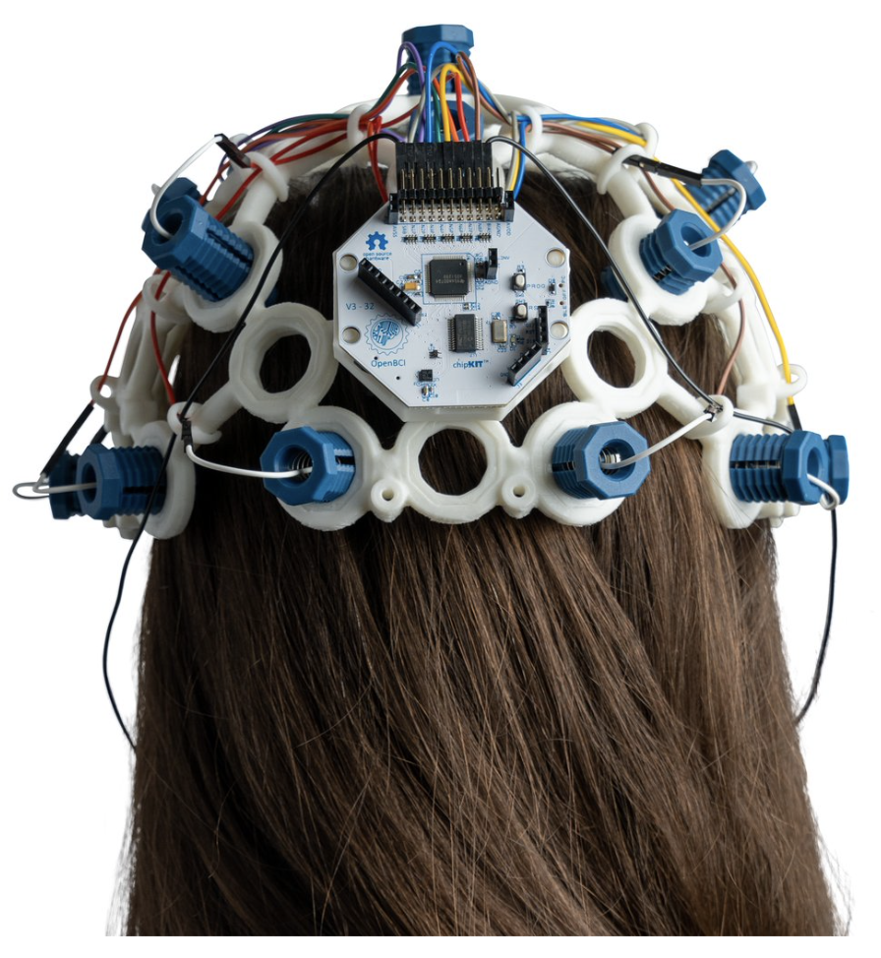
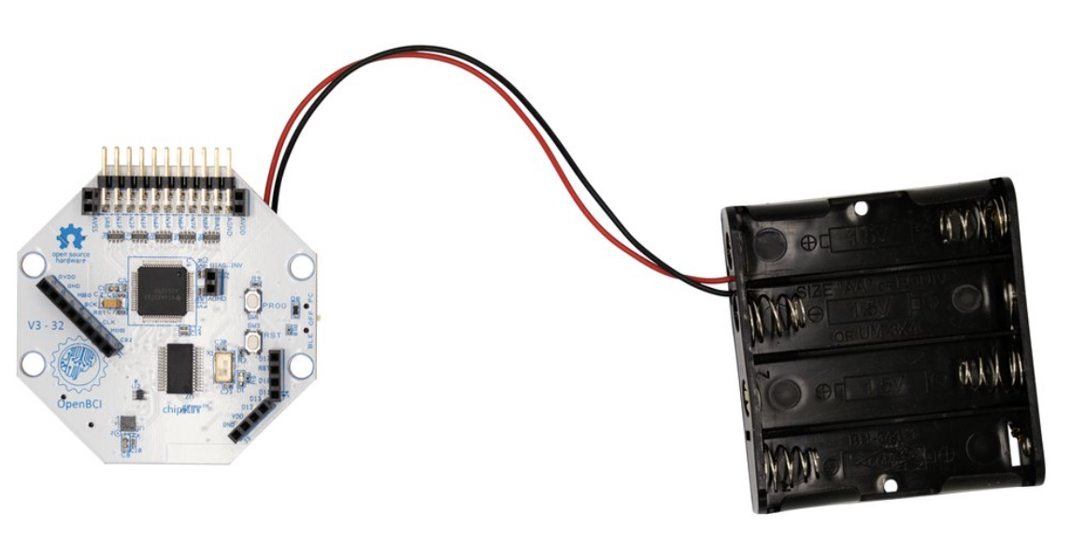
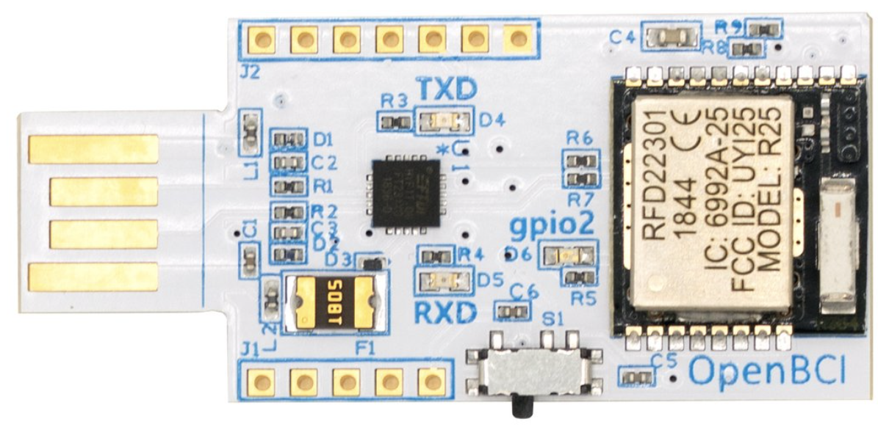
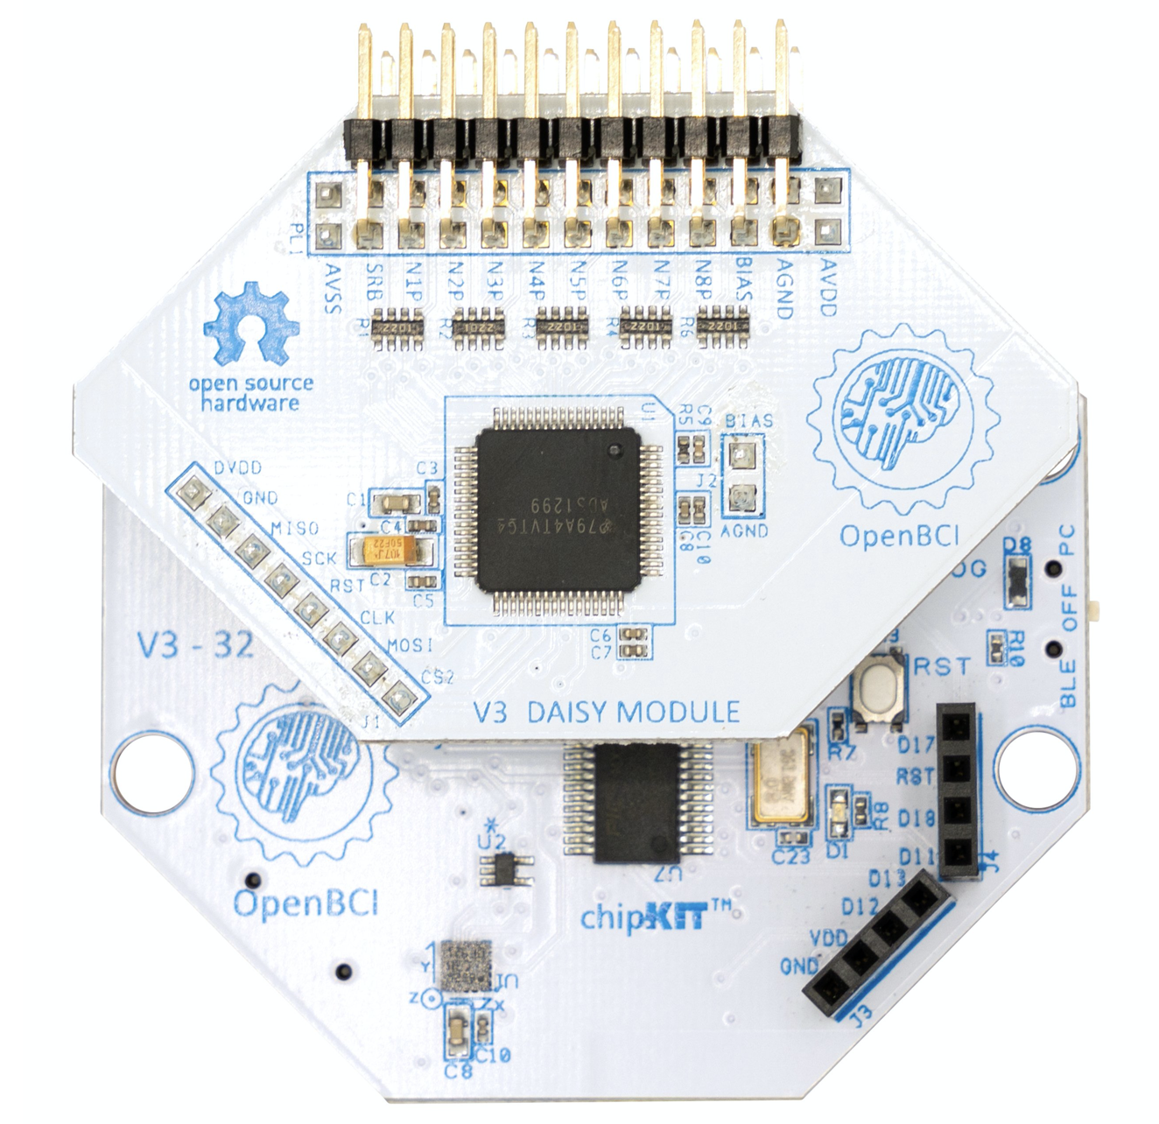
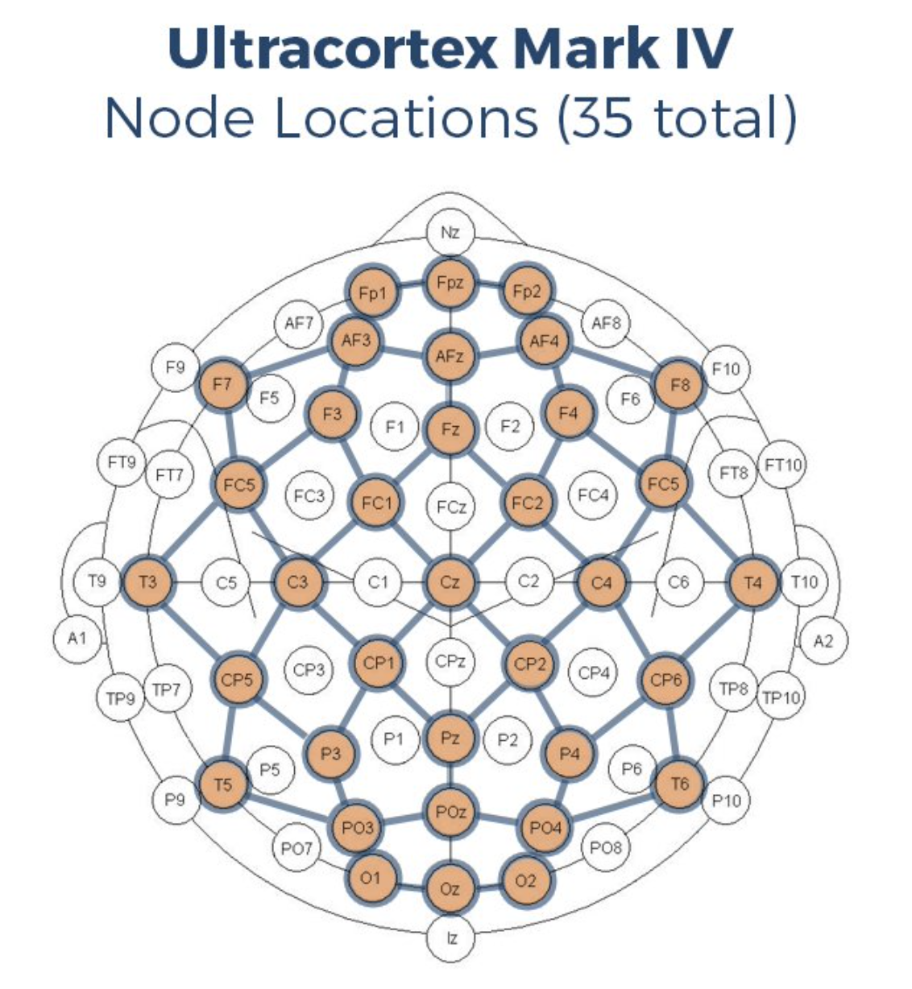
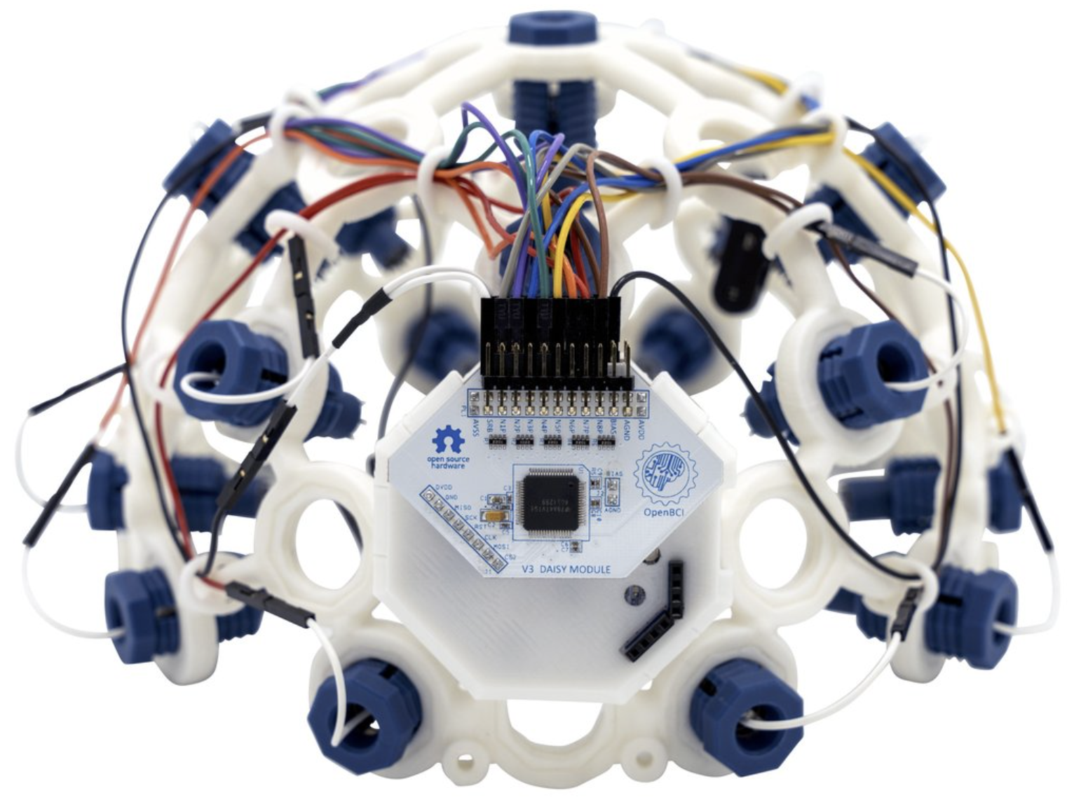
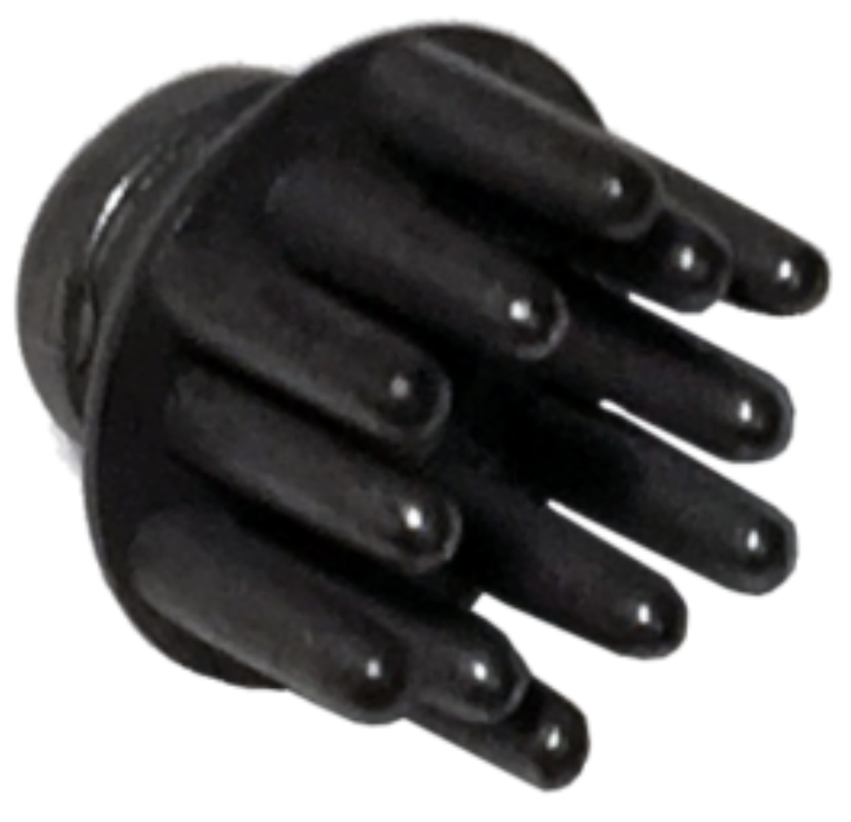
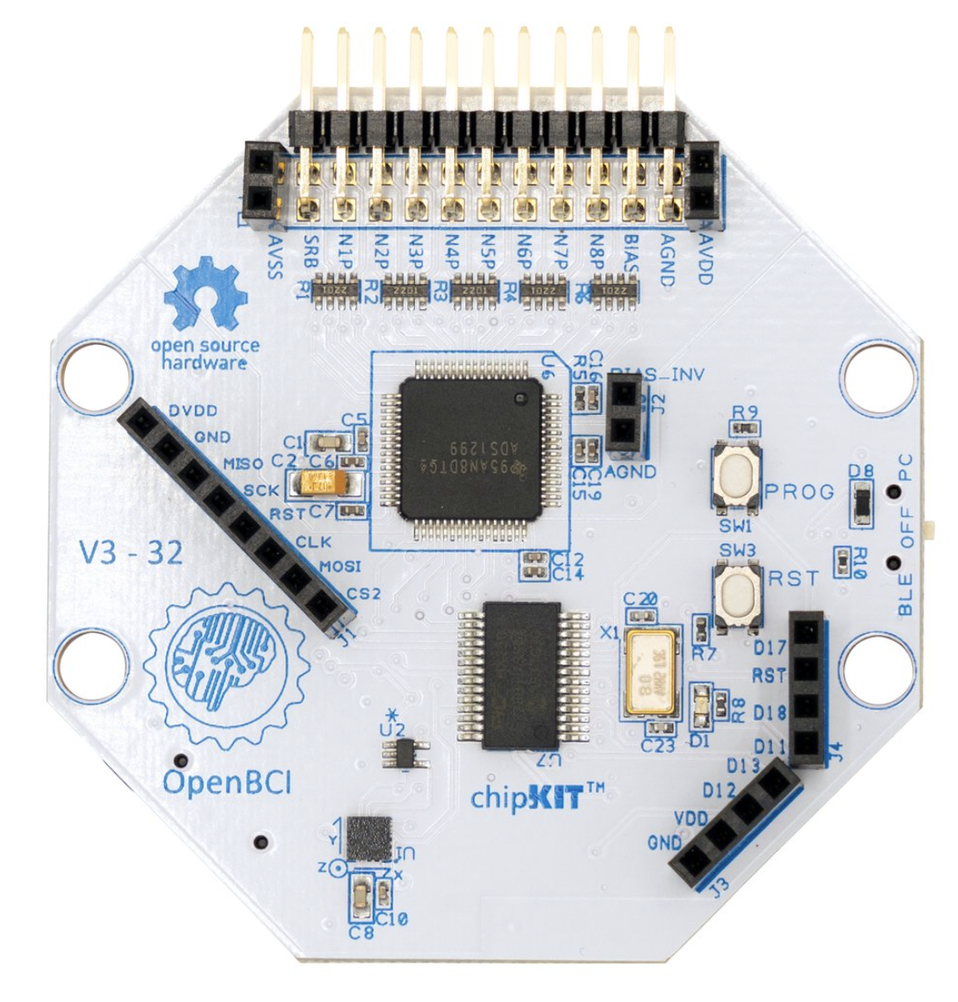
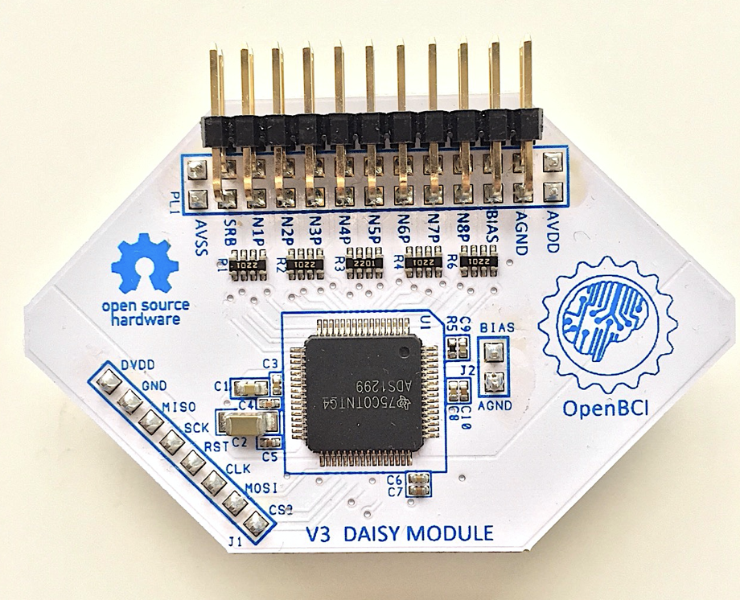
Specifications (OpenBCI Wireless 16-Channel System)
Ultracortex MARK IV EEG headset (3d printed)
35 possible node locations (10-20 layout)
Ag-AgCl electrode “combs”
OpenBCI Cyton board (8-channel; 24 bit)
OpenBCI Daisy module (extends Cyton to 16 channels)
Built-in 3-axis accelerometer (16 bit)
Bluetooth or local SD storage
OpenBCI programmable dongle (Bluetooth)

Slide 15

Usage (OpenBCI Wireless 16-Channel System)
Ideally suited for mobile data collection
Relatively inexpensive; good for piloting novel studies/designs
Could purchase multiple for “hyperscanning” studies
Will be using for a novel “golf task”

Slide 16
Caveats (OpenBCI Wireless 16-Channel System)
Low electrode density (can’t do perform topographical/source analyses)
Uncertainties regarding data quality, temporal precision, etc.
However, growing scientific support: https://docs.openbci.com/citations/

Slide 17
Documentation (OpenBCI Wireless 16-Channel System)
Ultracortex Mark IV: https://docs.openbci.com/AddOns/Headwear/MarkIV/
Cyton board: https://docs.openbci.com/GettingStarted/Boards/CytonGS/

Slide 18
Questions?
Next up: Collecting and Monitoring EEG

